Slide 1
Visualizing Fortune 500 Companies
By J.D. Sipala

Slide 2
What is the Fortune 500?

Slide 3


Profit
A company's net profit is the revenue after all the expenses related to the manufacture, production and selling of products are deducted
No business can survive for a significant amount of time without making a profit
Although a company can use financing to sustain itself financially for a time, it is ultimately a liability, not an asset

Slide 4

Growth
Growth for a business is essentially an expansion, making the company bigger, increasing its market and ultimately making it more profitable. Measuring growth is possible by looking at some pertinent statistics, such as overall revenue, number of employees, market share and turnover

Slide 5
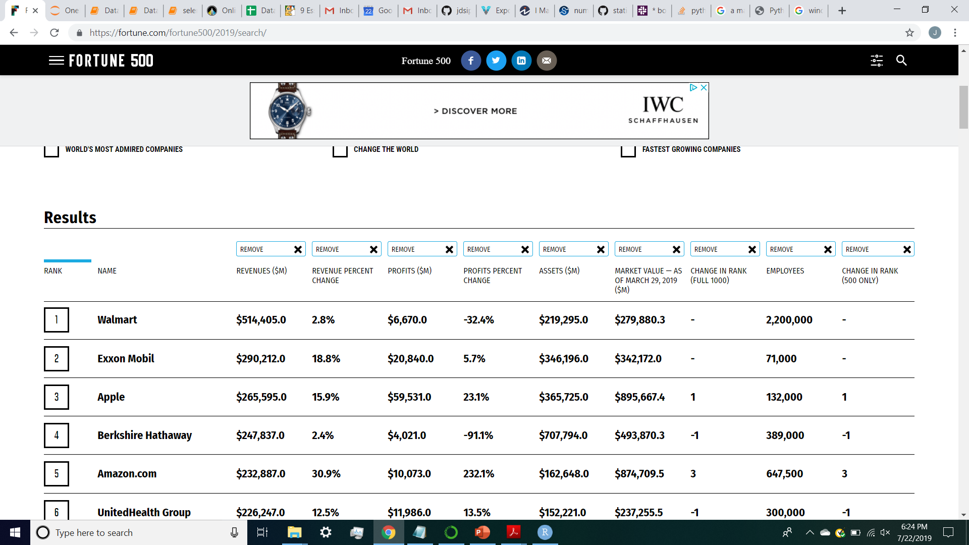

Slide 6
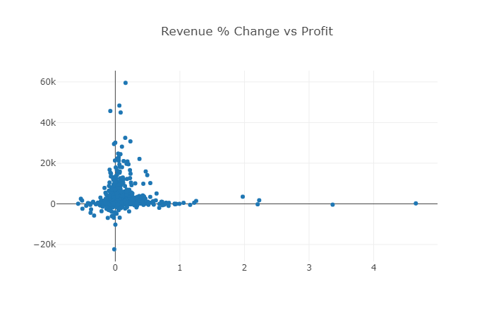
Profit Vs Growth

Slide 7
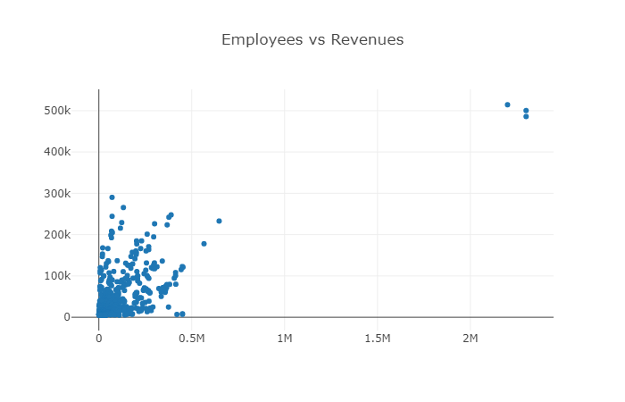
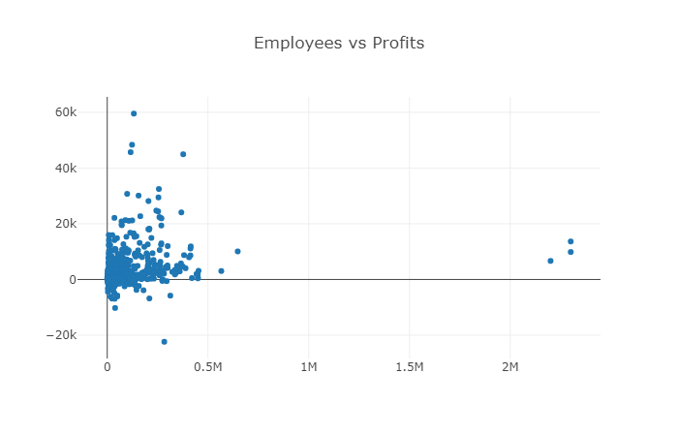

Slide 8
Market Value
A company’s market value is a good indication of investors’ perceptions about its business prospects. The range of market values in the marketplace is enormous, ranging from less than $1 million for the smallest companies to hundreds of billions for the world’s biggest and most successful companies.
Understand the numbers

Slide 9
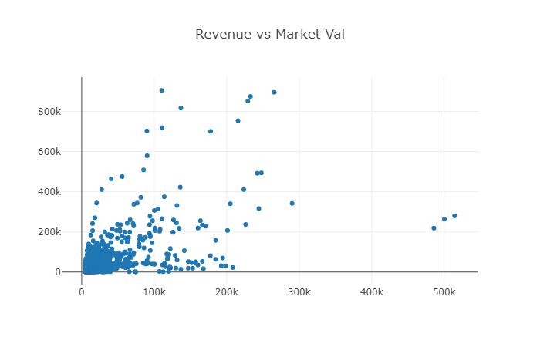

Slide 10
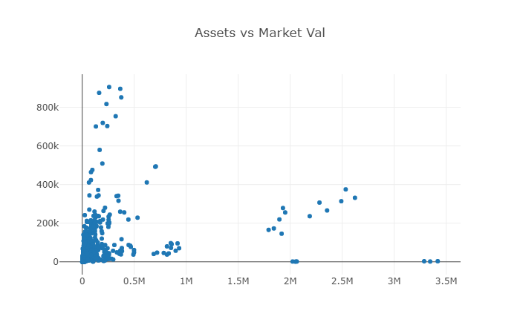

Slide 11
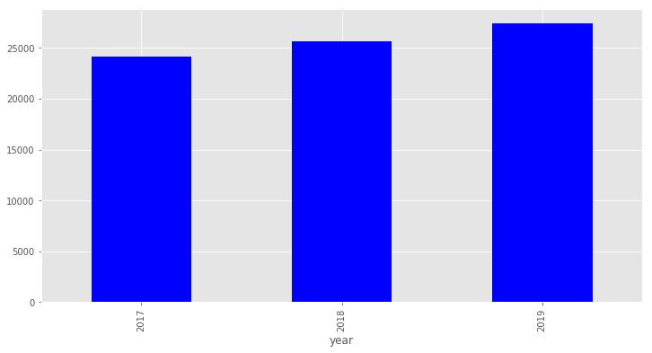
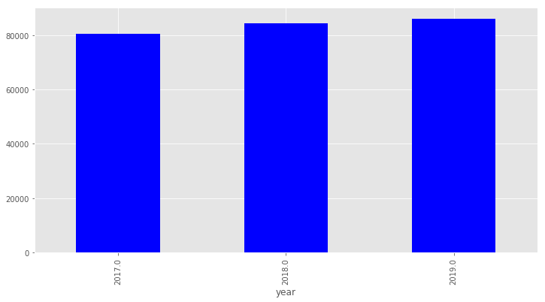
Avg Revenues Avg Assets by year by year

